Slide 1
Deputy Auditor Training
Fall 2021

Slide 2
Introductions
Name
Major
Year
Future?

Slide 3
What is this Position
Deputy Auditor - Assists in the process of auditing student organizations funded by RUSA Allocations through its’ Auditing Strategy
Work as a team to complete the strategy
Regular Audit - Collect Information, Review, Resolve (1-2 hours, 2 per week)
In-Person Audit - Attend Event to solidify audit (1-2 hours)
Meet together to discuss any specific manners or issues
Be of service to assist and guide student organizations

Slide 4
What is RUSA Allocations
“The RUSA Allocations Board is an affiliated committee of RUSA that operates separately from RUSA and is responsible for the allocation of funds to registered Rutgers University Student Organizations as well as various registered events on an as-needed basis.”
11 Members on the Board
Collects, reviews, and distributes funding amongst 300+ student organizations on campus
Continuously assists organizations throughout the semester with trainings, appeals, and service
Audits and upholds funding guidelines to ensure fair and efficient use of Student Fees throughout the semester
Auditor + Deputy Auditors

Slide 5
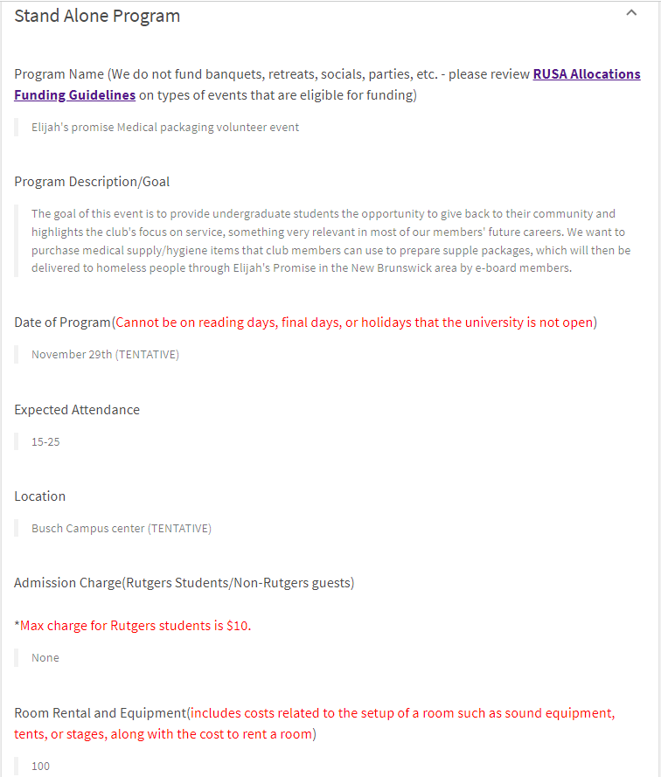
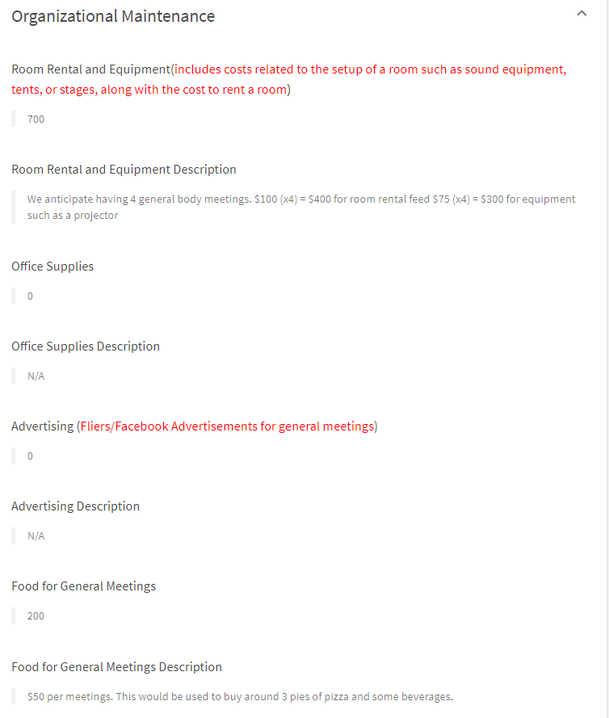
Budget Request - Guidelines

Slide 6
Audit Documents
Audit SOP
Audit Document
Audit Guidelines

Slide 7
Auditing Process - Pre-Audit
Information Collection
Start of Week - Send emails to the 2 designated clubs you are auditing
During Week - Look to make sure they will provide a response or have seen the email. If not send a follow up
End of Week - Finalize all procedure and data to be prepared for the upcoming audits

Slide 8
Auditing Process - Audit
Audit Review
Once information is reviewed, ask questions, clarify responses, and compare to our data
Should be keeping up with a timeline and following procedures
Make individual decisions and adjustments as needed

Slide 9
Auditing Process - Audit
Audit Meeting (Virtual)
Meet with the club president or treasurer over Zoom
Clarify and review all necessary topics from previous step
Organize and archive data
Audit Meeting (In-Person)
Attend the event with 1 other deputy auditor for about 30 minutes
Take specific notes and complete “Checklist”
If possible, talk to President or Treasurer for some details

Slide 10
Auditing Process - Post-Audit
Audit Clarifications and Conclusion
Ensure that the Treasurer and President are in a satisfied state (No more questions/concerns, given all resources they seek, understanding of our job)
Logistical archive of data and adjustments of priority points

